Slide 1
Music Festival Giveaway
Team 5

Slide 2
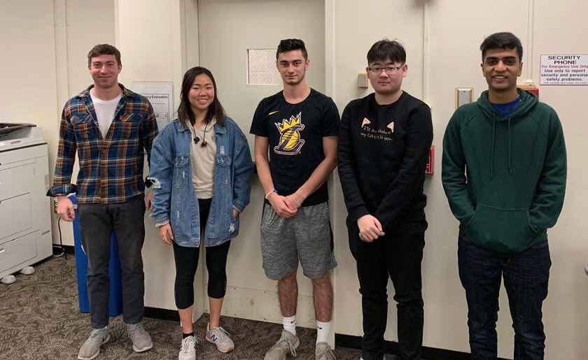
Jackson 5 Members
Kosta Karagan
Josh Kravetz
Sami Masaki
Aman Patel
Krist Qu

Slide 3
Intro
Our group was tasked with finding the most efficient way for an annual music festival to hold a giveaway. The giveaway consists of various items including free tickets, meet and greets, and t-shirts. To get to the bottom of this problem, we had to first find which platform reached the largest number of our target audience- those that are between 18-34 years old. We also had to figure out which method would best allow us to collect the most amount of data from the users. Large, established music festivals in the past have taken to social media and email to hold giveaways and create excitement and buzz around the music festival. Popular social media choices included Instagram and Facebook. Our group analyzed this problem to reach our chosen method for this giveaway.

Slide 4
Problem?
One of the main issues that we have to tackle is finding the best ways to reach out to people and promote the event. In the past, concerts have used many marketing strategies including social media giveaways and emailing people who could possibly be interested. Since this concert would be taking place on a large college campus, it would be difficult to promote the event by just word of mouth. Since the demographic that we are targeting is 18-34 year olds, we need to utilize technology and promote these giveaways on people’s phones, computers, and tablets.

Slide 5
Scenario
Bloomington’s annual concert consists of many different artists and bands. This year, it has been brought up that the festival wants to do a giveaway with various items. These items include tickets, merchandise, and meet and greets. Our job is to find an effective way to promote the event and target a clear demographic through social media, email, and flyers around the school.

Slide 6
Types of Research
Primary
SurveyMonkey survey
Results
Secondary
Article Summaries
Brief summary of each article

Slide 7
SurveyMonkey Survey
Our survey consisted of three questions with a natural progression. The questions were as follows:
Do you usually enter giveaways when you come across them?
What is your prefered method of entering a giveaway?
What social media platform do you use most frequently?
Interestingly enough all participants filled out the first two questions while a few missed the final question, although we do not believe that our survey results are skewed.

Slide 8
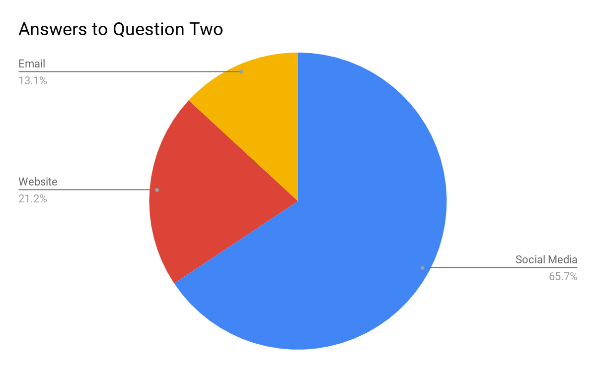
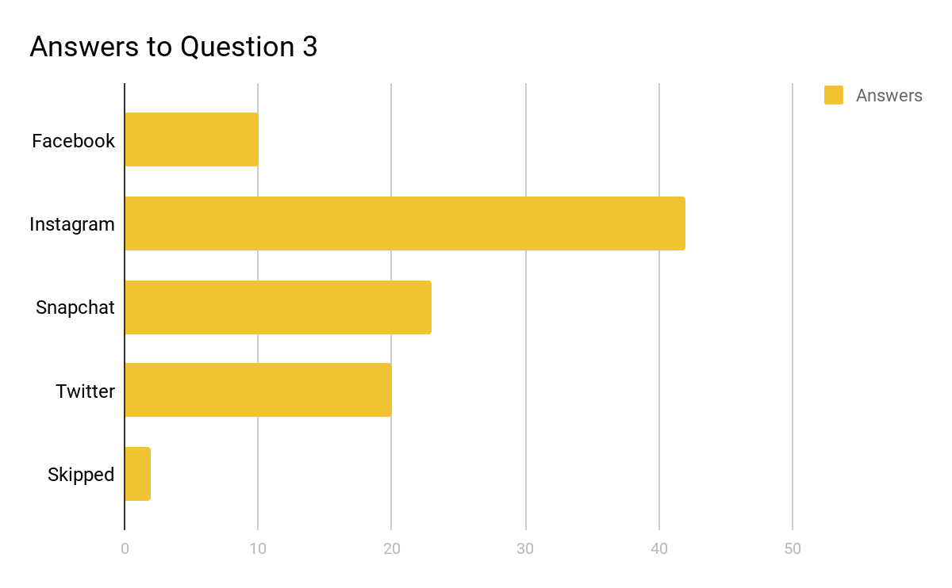
Data Set and Visualization
Do you usually enter giveaways when you come across them?
Yes | No
20.90% | 79.10%

Slide 9
Results
Although the majority of people prefer not to participate in giveaways, the survey results suggest that those who do choose to enter through social media, and that the most attractive social media platform is instagram.

Slide 10
Insights and Impact
Insights
People tend to use social media to participate in giveaways over email and other websites.
The best place to entice our demographic is Instagram.
For the demographic we chose, we should stay away from doing the giveaways on Facebook.
Impact on Our Solution
Based on the results and insights derived from them, there is no doubt that the best way to promote our giveaway is over social media via the app “Instagram”. The survey results suggest that Instagram is the avenue with the most target rich demographic for apparel giveaways regarding concert promotion.

Slide 11

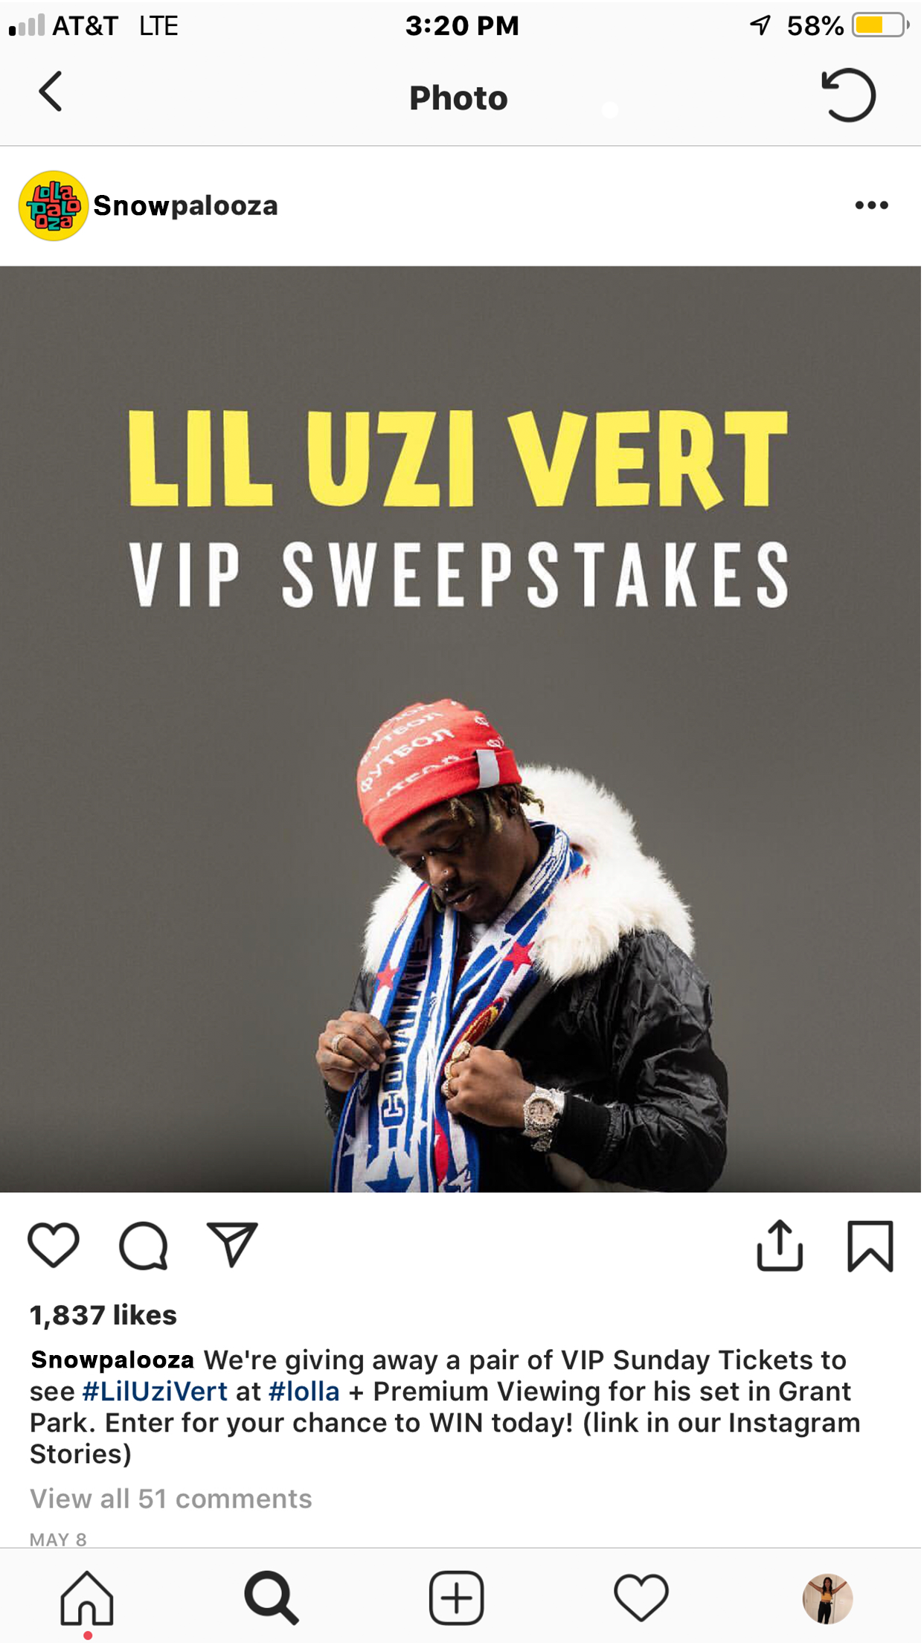
Solution Design
18-34 Target Demographic
Easy and simple to use for both parties
Collects a wide variety of data

Slide 12
Thanks!
Any questions?

